Slide 1

From Gaps to Growth: Understanding What Drives Global Startup Formation
Swaraj Rai ’25 – Economics | Data Science Certificate | Global South Asian Studies
Advisor: Professor Maryam Gooyabadi

Slide 2
Roadmap for the Day
Background
Empirics: Entrepreneurial Drivers
The Data
Methodology
Results
Discussion
Limitations
Thank-You's
Conclusions + Future Work

Slide 3


Background & Motivation
In the News:
1)Entrepreneurial Background
2)Outcomes in Development
3)Room to Contribute to Literature
Why Entrepreneurship?
Question:
“Why do startups flourish in some nations and falter in others?”

Slide 4
Entrepreneurial Landscape
Access to Capital
Reduction in liquidity restraints supports risk-taking
Strong correlation between financial access and investment behavior (Demirgüç-Kunt et al., 2022)
Education & Human Capital
Becker (1964) and others link education with startup success — but not always.
In some regions, educated individuals opt out of entrepreneurship in favor of high-skill employment (Amorós & Bosma, 2014).
Government Institutions
Women face higher barriers: legal restrictions, access to finance, administrative burdens (Minniti & Naudé, 2010).
Regulatory quality, rule of law, and political stability are correlated with SME formation. (Aidis et al., 2008)
Gender Equity
But: capital alone doesn’t foster startups unless paired with institutional trust and reform (Banerjee & Duflo, 2011).
Institutional quality shapes the cost, risk, and feasibility of forming new businesses.
ILO (2018); Chen (2001): Women are disproportionately concentrated in informal sectors globally, often operating outside legal and financial systems.
Ie: “Brain Drain”
Notes:
Combine literature references to accompany each identified pillar

Slide 5


Data Collection
Data Sourcing:
Almost all data was exclusively sourced from World Bank
Except for Region Indicators
Consistent country-year left join merge
Supplementary Region Data from UN Statistics Division
Regional and Sub-Regional codes
Source: World Bank
Final Dataset:
N = 2365 -> 391 after NA filtering
Years: 2011, 2014, 2017, 2021
27 Columns
125 unique countries
82 of which have n_years >= 3
Source: UN Statistics Division
Notes:
countries' regional, and sub-regional codes

Slide 6
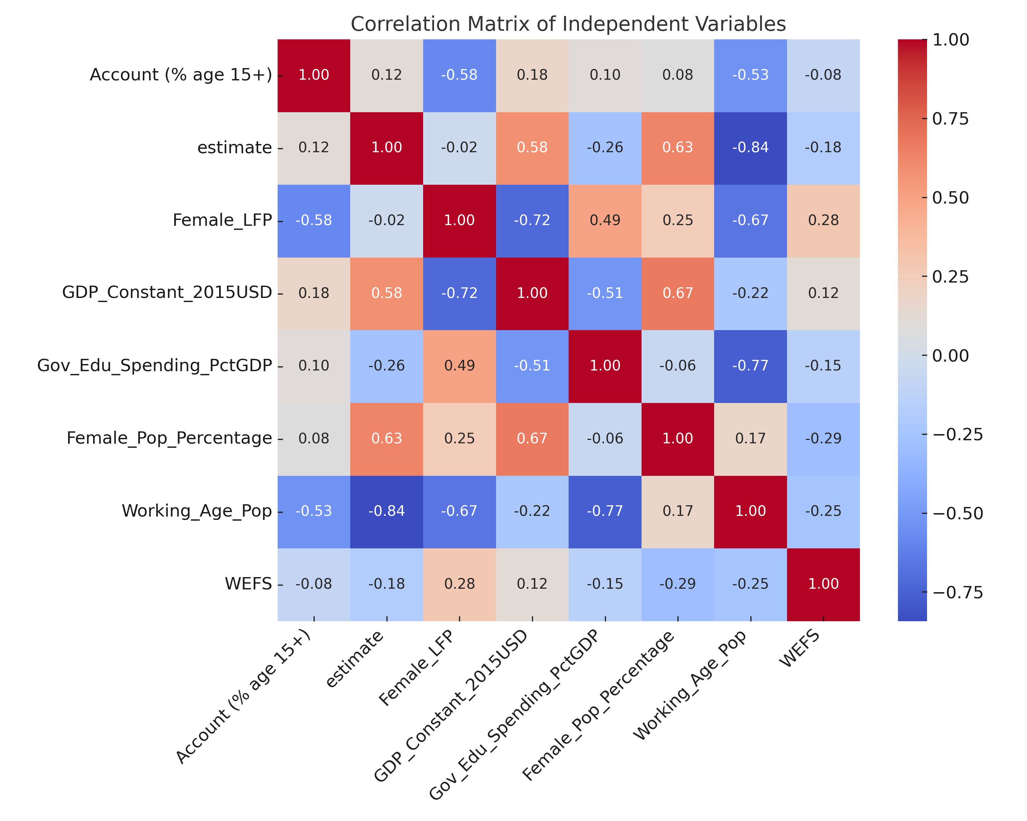
Data at a High-Level
Final Independent Variables
Domain | Variable Name | Description
Finance | Account (% age 15+) | Share of adults with a financial account (Global Findex)
Governance | Estimate (WGI) | Control of corruption proxy (World Bank Governance Indicator)
Gender | WEFS | Women’s Entrepreneurship Feasibility Score
Macroeconomic | GDP_Constant_2015USD | Constant-price GDP (control)
Demographic | Female_Pop_Percentage | % of population that is female – proxy for Gender Distribution
Demographic | Working_Age_Pop | % of population age 15–64 – proxy for Age Distribution
Education | Gov_Edu_Spending_PctGDP | Government expenditure on education as % of GDP
Correlation Matrix:
Dependent Variable: New Business Density Rate (NBDR)
Newly registered corporations per 1,000 working-age people (those ages 15–64).
Help understand the trends in new firm creation across
Notes:
Mention additional variables dropped due to missingness: Ease of doing business rank, Logistics Performance Index (LPI), Literacy Rates (across both genders), Gini Inequality Index

Slide 7
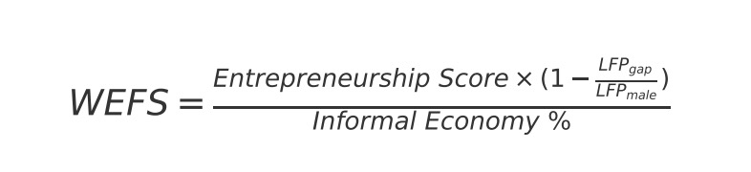
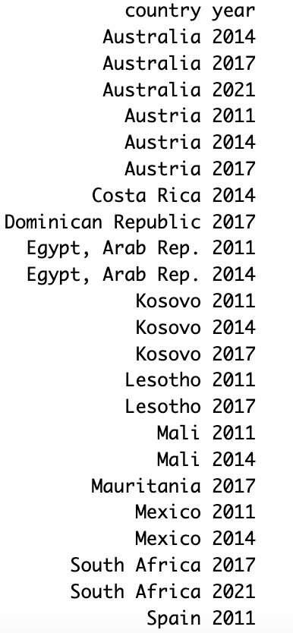
Data – Deep Dive
Crafting the Women’s Entrepreneurship Feasibility Score (WEFS):
NBDR Outlier Inferencing (Cook’s Distance):
WEFS - Why this formula?
Takes the Pre-existing World Bank Entrepreneurship Score for a given country-year
Labor Force Participation Gap (LFPₘₐₗₑ − LFP_{f}ₑₘₐₗₑ) penalizes contexts where women are systemically excluded from economic activity
Dividing by Informal Economy % reflects added difficulty of launching formal enterprises in high-informality environments
(ILO, 2018)
Notes:
Mention additional variables dropped due to missingness: Ease of doing business rank, Logistics Performance Index (LPI), Literacy Rates (across both genders), Gini Inequality Index

Slide 8
Methodology
1) Time-Series
2) Pivot to Conventional Models
An initial goal of conducting ARIMAX, GARCH, and Granger Causality Inferencing
Limited Temporal Depth (Limitation)
OLS (Single, Multi, Stepwise)
3) Cluster Analysis
Feature-Based Static
Dynamic Time Warping (DTW) with K-Medoids
Random Effects, Fixed Effects, Mixed Effects
Dynamic OLS, Pooled OLS
Having attempted Stochastic, Deterministic Modeling was the path charted - due to Temporal Depth Limitations

Slide 9
Methodology – Deterministic Models
Model type:
Model | What It Does | Why It's Used | Limitations
Basic OLS (Single & Multivariate) | Estimates relationships without accounting for panel data structure. | Interpretable, fast; good for initial diagnostics. | No panel structure; assumes independent observations.
Stepwise Regression (AIC) | Selects predictors by optimizing model fit using Akaike Information Criterion. | Reduces noise, avoids overfitting, keeps model parsimonious. | Can exclude theory-driven predictors; risk of overfitting to training data.
Fixed Effects (FE) | Controls for time-invariant traits by focusing on within-country variation. | Ideal when isolating the effect of policy or access changes within countries. | Drops time-invariant variables; requires within-unit variability.
Random Effects (RE) | Assumes country-specific effects are random and uncorrelated with predictors. | Useful for comparing across countries and estimating effects of slower-changing variables. | Biased if random effects are correlated with predictors.
Mixed Effects | Combines fixed and random effects in a hierarchical structure. | Captures both country-specific variation and general effects. | More complex interpretation; sensitive to specification.
Pooled OLS | Treats all observations as one large dataset, ignoring country or time structure. | Baseline model to estimate overall effects across countries and years. | Ignores unobserved heterogeneity and time/country effects.
Dynamic Pooled OLS | Adds lagged dependent variable to capture momentum, pooled across panel. | Models temporal persistence; best-performing model for forecasting and explanation. | Assumes uniform dynamics across countries; no country-specific error structure.
Note: Dynamic Pooled OLS accounts for startup persistence over time, while Pooled OLS does not.

Slide 10
Methodology – Deterministic Models Use Cases
Use case:
Model | Handles Lagged DV | Includes Fixed Effects | Accounts for Heterogeneity | Best For
Pooled OLS | ❌ | ❌ | ❌ | Estimating global averages across all country-year observations.
Dynamic Pooled OLS | ✅ | ✅ (region-level only) | ✅ (region-level only - but assumes uniform country-level dynamics) | Forecasting NBDR using past values and controlling for region-level context.
Multivariate OLS | ❌ | ❌ | ❌ | Establishing baseline relationships between predictors and NBDR.
Stepwise Regression (AIC) | ❌ | ❌ | ❌ | Selecting the most statistically useful variables from a larger set.
Fixed Effects (FE) | ❌ | ✅ | ✅ (within-country) | Isolating how internal changes (e.g., WEFS reform) impact NBDR over time.
Random Effects (RE) | ❌ | ❌ | ✅ (cross-country) | Comparing countries under the assumption that unobserved traits are random.
Mixed Effects | ❌ | ✅ | ✅ (both fixed & random) | Capturing nested variation: how countries differ, and how they trend overall.
A strong candidate for a leading deterministic model…

Slide 11
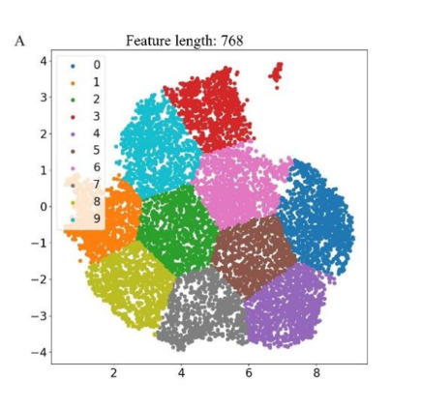
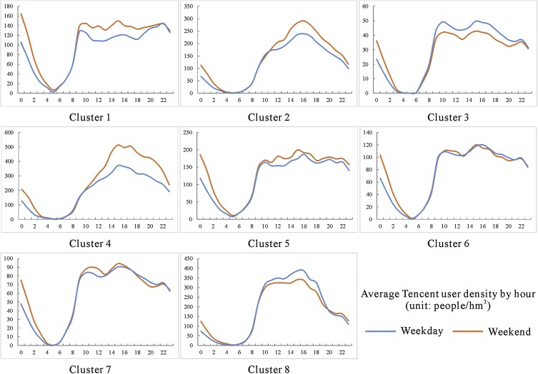
Methodology - Static vs. Temporal Clusters
Visual Example:
Clustering Method | What It Does | Why It's Used | Limitations
Feature-Based Static | Groups countries based on similar values NBDR features (Mean, Slope, Variance, Range, Autocorrelation, & First difference variance | Helps to segment countries into static “entrepreneurship ecosystems” based on features. | Assumes spherical clusters; sensitive to outliers and variable scaling.
DTW (with K-Medoid) | Clusters countries based on trajectory of startup activity using Dynamic Time Warping (DTW). | Captures temporal patterns in NBDR; useful when comparing how countries evolve over time. | Requires ≥3 years of data; medoids are less interpretable than centroids.
Notes:
Why clusters: While regressions explain why, clusters help us understand who behaves similarly

Slide 12
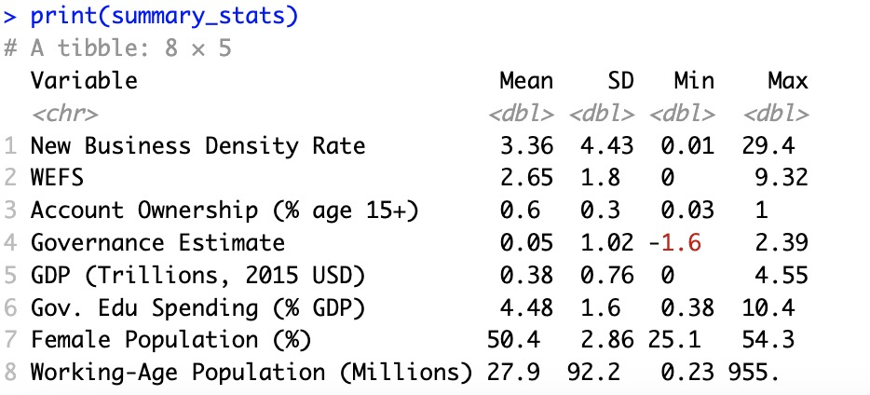
Results – Descriptive Statistics
New Business Density Rate (DV)
Independent Variables
Notes:
Top Left (Line Chart):
Noticeable dip in NBDR around 2009–2010, likely post-financial crisis.
Gradual rise post-2015, with a spike after 2020 — may reflect digital registration or COVID-era policies.
Trend supports the use of time-aware models like Dynamic Pooled OLS.
Bottom Left (Histogram):
Distribution is heavily right-skewed — most countries have low startup density.
Log transformation helps normalize this for regression analysis.
Highlights structural constraints in many economies.
Right (Summary Table):
Wide variation across predictors:
Governance ranges from -1.6 to 2.4.
GDP from ~$0 to $4.55 trillion (2015 USD).
WEFS and Account Ownership vary significantly — suggesting access gaps.
Female population stable; working-age population ranges widely (from 0.23M to 955M).
Government education spending averages ~4.5% of GDP, with meaningful cross-country differences.

Slide 13
Results – Single OLS Regression
Results:
Observations:
All significant – except for GDP
Noteworthy variables:
1) wgi_estimate (R^2 = 34.9%)
2) account_15plus (R^2 = 31.6%)
3) WEFS (R^2 = 26.3%)
Notes:
Single vs. Uni
-Make sure to compare significance status in single vs. multi (confounder, newfound significance, etc.)

Slide 14
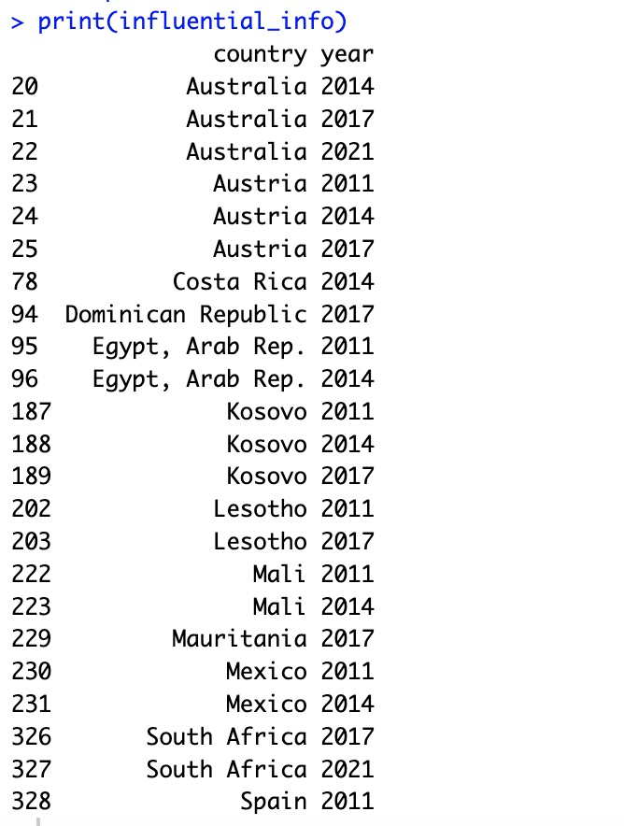
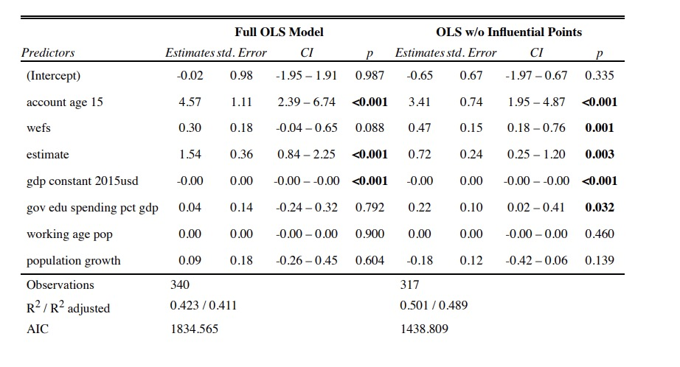
Results – Multivariate OLS Regression
Results:
Observations:
Country Outliers:
account_15plus and wgi_estimate retain significance
WEFS retains significance after outlier exclusions
After outlier exclusion - wgi_estimate and account_15plus lose magnitude
Notes:
Single vs. Uni
-Make sure to compare significance status in single vs. multi (confounder, newfound significance, etc.)

Slide 15
Results – Panel & Pooled
Model Comparison:
Observations:
WEFS stays significant in RE, Mixed, and Stepwise models.
Governance estimate consistently positive across models.
Lagged DV is strong in Dynamic Pooled OLS → confirms persistence.
Best performing model is by far the Dynamic Pooled OLS
Notes:
“While Fixed Effects help control for country-level bias, they lose time-invariant variables.”
“Random Effects and Mixed Models retain key variables like WEFS and Governance.”
“Dynamic Pooled OLS performed best, capturing momentum through lagged startup activity.”

Slide 16
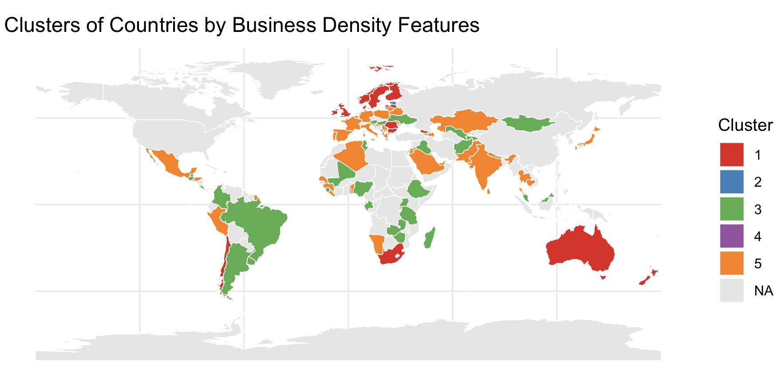
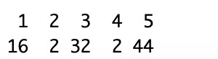
Results – Static Clusters
3) Cluster Profiles
1) Deriving Optimal Number of Clusters:
2) Cluster Plot
Note:
Notes:
Speaker Notes:
1. Optimal Clusters (Elbow + Gap Statistic):
“Both the Elbow and Gap statistic point to 5 clusters as the most meaningful separation of country groups based on entrepreneurial features.”
2. Cluster Map + PCA Plot:
“We observe clear geographic tendencies — some clusters align along regional lines (e.g., Sub-Saharan Africa in Cluster 1), while others group countries across continents based on similar enabling conditions.”
3. Cluster Profiles:
“Cluster 5 shows a sharp upward trend in startup density — likely mature economies or emerging hubs.”
“Clusters 1 and 2 are flat or declining — often lower-income or less formalized economies.”
“Radar chart shows that Cluster 3 scores highly across enabling factors, while Cluster 1 scores negatively on most.”

Slide 17
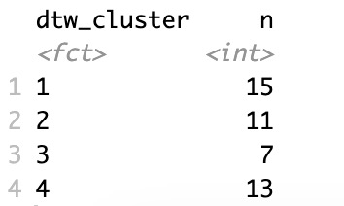
Results – Dynamic Clusters
1) Cluster Plot
2) Cluster Profiles
3) Observations:
Here, we group countries based on the temporal trajectory of their business density — not just the level, but how it changes over time.
Cluster 4 is the highest-performing trajectory — countries like Australia and the UAE show strong upward growth in NBDR over time.
Cluster 1, by contrast, represents stagnant or modestly growing countries with limited variation in enabling features.
Confirms that startup growth momentum is not homogenous — and policies must be cluster-specific.
Notes:
1. DTW Map:
“Here, we group countries based on the temporal trajectory of their business density — not just the level, but how it changes over time.”
2. Cluster Profiles:
“Cluster 4 is the highest-performing trajectory — countries like Australia and the UAE show strong upward growth in NBDR over time.”
“Cluster 1, by contrast, represents stagnant or modestly growing countries with limited variation in enabling features.”
3. Time Series Plot:
“You can see that Cluster 4 accelerates sharply, while Cluster 2 and 3 show gradual but steady improvement.”
“This confirms that startup growth momentum is not uniform — and policies must be cluster-specific.”
4. Why This Matters:
“Static clusters tell us what the environment looks like, while dynamic clusters reveal how countries are evolving — offering more targeted policy implications.”

Slide 18
Discussion
1) Key Takeaways from Results
WEFS is a consistent and interpretable predictor of entrepreneurial activity — despite being a composite.
2) Implications for Policy
Tailored support by cluster: Countries in low-growth clusters may benefit from institutional reforms + access expansion.
3) Contribution to the Literature
Expands existing work by linking gendered feasibility, financial access, and informality into a unified framework (via WEFS).
Governance quality and account access emerge as foundational drivers across most model types.
Lagged startup activity (in Dynamic Pooled OLS) reinforces the idea of “entrepreneurial momentum.”
Clusters reveal heterogeneity not captured by income levels or region alone.
Women’s economic inclusion (via LFP and informal economy metrics) is not only equity-driven but growth-relevant.
Digital financial infrastructure (proxy via account ownership) could be a cost-effective intervention lever.
Entrepreneurial persistence should be nurtured — via long-term support systems, not one-off grants.
Demonstrates the value of combining static and dynamic clustering to uncover both structural and behavioral patterns – with certain key limitations to be addressed in future work.
Offers a pragmatic, replicable model using publicly available data for cross-country startup diagnostics.

Slide 19
Limitations
Temporal Limitations
NBDR Excludes Informal Activity
Clustering Interpretation
Causality Limitations
Composite Variable Assumptions (WEFS)
Data At Hand
Measurement Limitations
Modeling
Inability to Cross Validate
Notes:
🟫 Slide Content (Bullet Format)
🔸 1. Temporal Limitations
The short time span of available panel data limited the use of advanced time series methods (e.g., ARIMA, Granger, GARCH).
Forecasting was constrained to simplified pooled dynamics (e.g., Dynamic Pooled OLS).
🔸 2. Informal Entrepreneurship Not Fully Captured
New Business Density Rate (NBDR) only reflects formal firm registration.
Many countries with high entrepreneurial activity but large informal sectors may be underrepresented.
🔸 3. Composite Variable Assumptions (WEFS)
WEFS assumes equal weightings and interaction structure between components (e.g., informality, LFP gap).
Sensitive to quality and availability of underlying indicators.
🔸 4. Clustering Interpretation
Cluster outcomes are sensitive to initial seeds and normalization decisions.
DTW clustering omits countries with <3-year time series, excluding some LICs or volatile states.
🔸 5. Causality Limitations
Models are predictive, not causal. Endogeneity (e.g., reverse causality between account access and startups) remains a potential bias.

Slide 20
Conclusions + Future Work
Data Collection
Incorporate proxies for informal entrepreneurship (e.g., mobile money, labor force surveys).
Close Data Gaps (ie: Literacy Rates, GINI Inequality Index, etc.)
Research Design
Explore IVs, natural experiments, or RDDs to validate directional effects.
Use modeled results to simulate outcomes from closing access or governance gaps.
Longitudinal Expansion
Extend dataset to better support time-series methods (ARIMA, GARCH, Granger).
Zoom into state/province-level dynamics within large, diverse economies
Incorporate Missing Countries
Future Work:
Conclusions
Access, equity, and governance matter
WEFS is a strong synthetic indicator
Entrepreneurial ecosystems show inertia
Notes:
✅ Left Column: Key Conclusions
Access, equity, and governance matter: Account ownership, gender inclusion, and governance quality are persistent predictors of formal startup density.
WEFS is a strong synthetic indicator: Despite its simplicity, it captures multi-dimensional constraints in low-data settings.
Entrepreneurial ecosystems show inertia: Dynamic Pooled OLS confirms that past density influences future trends — growth is path-dependent.
✅ Future Research Directions
Longitudinal expansion: A) Greater n number of years across the board: Extend dataset to better support time-series methods (ARIMA, GARCH, Granger). B) Subnational analysis: Zoom into state/province-level dynamics within large, diverse economies.
Research Design: A) Causal designs: Explore IVs, natural experiments, or RDDs to validate directional effects. B) Policy simulation: Use modeled results to simulate outcomes from closing access or governance gaps.
Data Collection: A) Informality modeling: Incorporate proxies for informal entrepreneurship (e.g., mobile money, labor force surveys). B) Close Gaps in Data that short analyses (ie: Literacy Rates, GINI Inequality Index, etc.)

Slide 21
Note of Appreciation
Thank you to Professor Maryam Gooyabadi for guiding me on this journey. I am grateful for your time, council, and wisdom throughout this project’s tenure.
Thank you to Professor Manolis Kaparakis for heading the QAC and serving as an additional pillar of support in the QAC.
And lastly, thank you to the broader Wesleyan Community for an exceptional four years of critical thinking - in helping foster curiosity for what lies beyond in the world of Business, Data, and Civic Engagement.

Slide 22

Thank You for attending! Any questions?

